Slide 1


Slide 2
PROJECT PRESENTATION BATCH-5864
DONE BY Guided By
Akshayaa .T Mr. Santosh Mali(Trainer)
Ahil. D
Vivek .N.S

Slide 3
UNIQUE ID CODE GENERATION

Slide 4
TECHNICAL SPECIFICATION
HTML
CSS
JAVASCRIPT

Slide 5
MODULES
HOME PAGE/LOGIN PAGE
PERSON DETAILS
REGISTRATION FORM
GET ID PAGE
ABOUT US
CONTACT

Slide 6
INTRODUCTION
Unique ID system provides single source offline/online identity verification across the country for the residents.
Once residents enroll, they can use their unique ID number to authenticate and establish their identity multiple times using electronic means or through offline verification, as the case may be.
To get the unique ID, user should register in our website with their proper details, registration details should be validated and after that the unique id will be generated with the password according to the given details.
Users can login with their unique ID and password to view their details.

Slide 7
HOME PAGE/LOGIN PAGE
This page was developed by Ahil D
This page was developed for login purpose.
And also to generate a new unique id for new user.

Slide 8
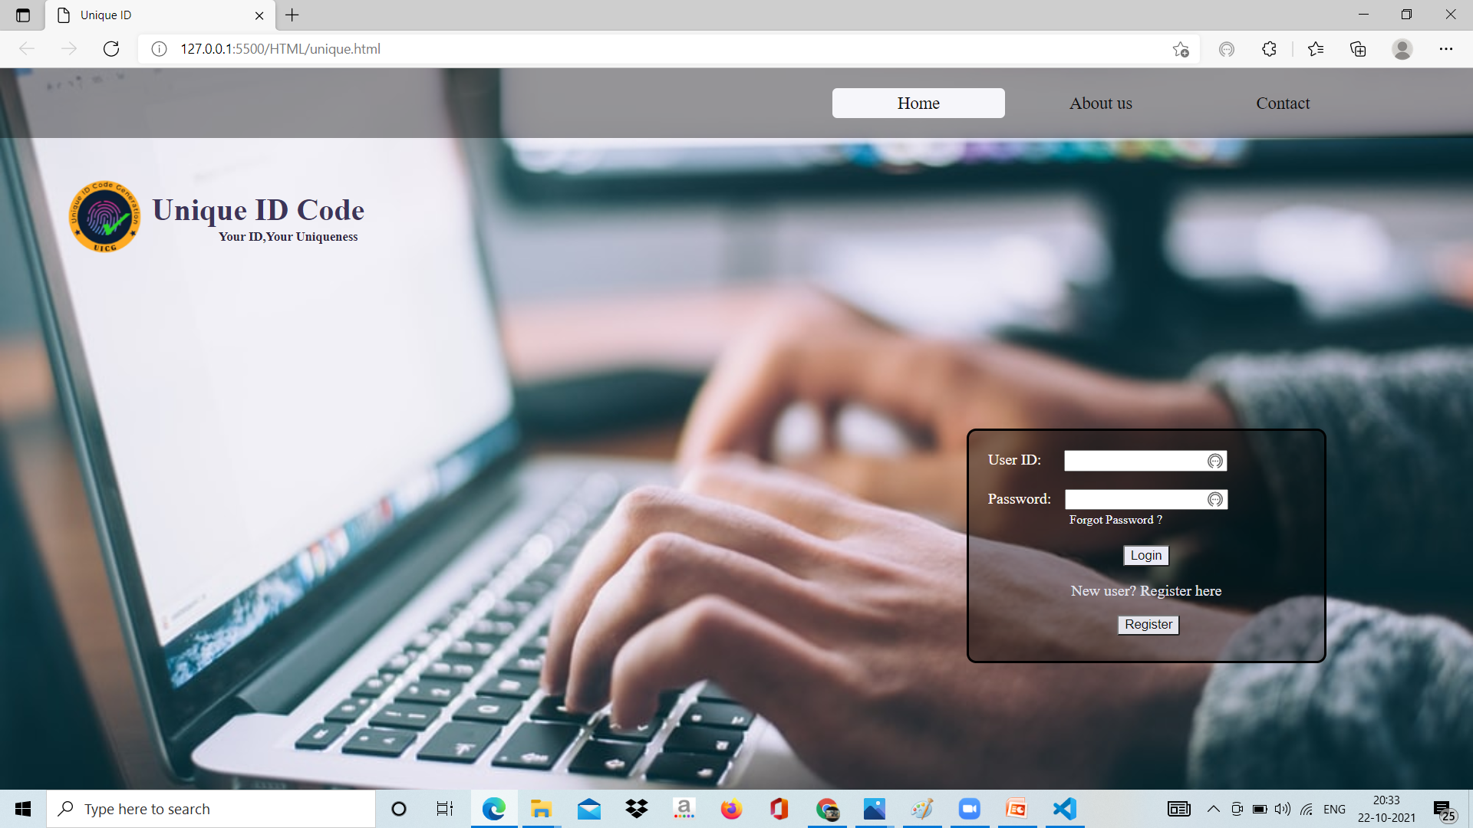
Home Page

Slide 9
PERSONAL DETAILS
This page was developed by Ahil D
Here, user can view their personal details which is entered in the registration form.
After viewing ,they can return to home page using logout option or button.

Slide 10
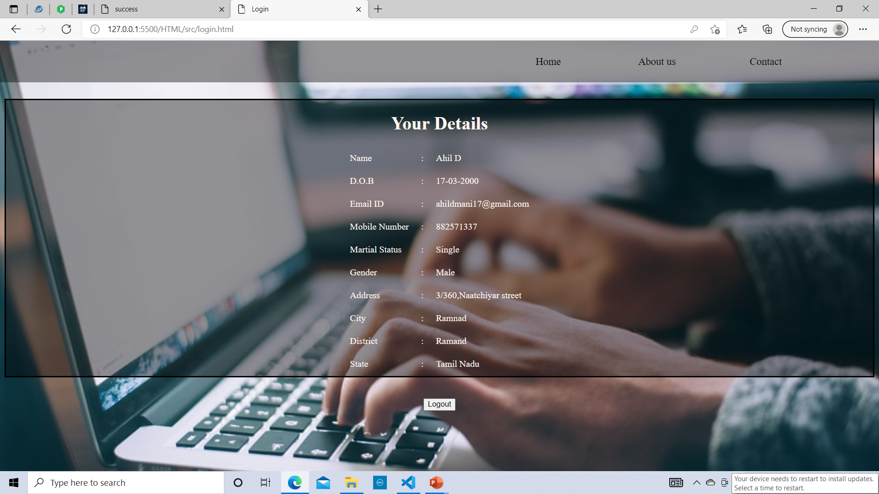
Personal Details Page

Slide 11
REGISTRATION FORM
This page was developed by Akshayaa T
This page was developed to get the user details using HTML form.
This page will also alert the user to give the valid information.

Slide 12
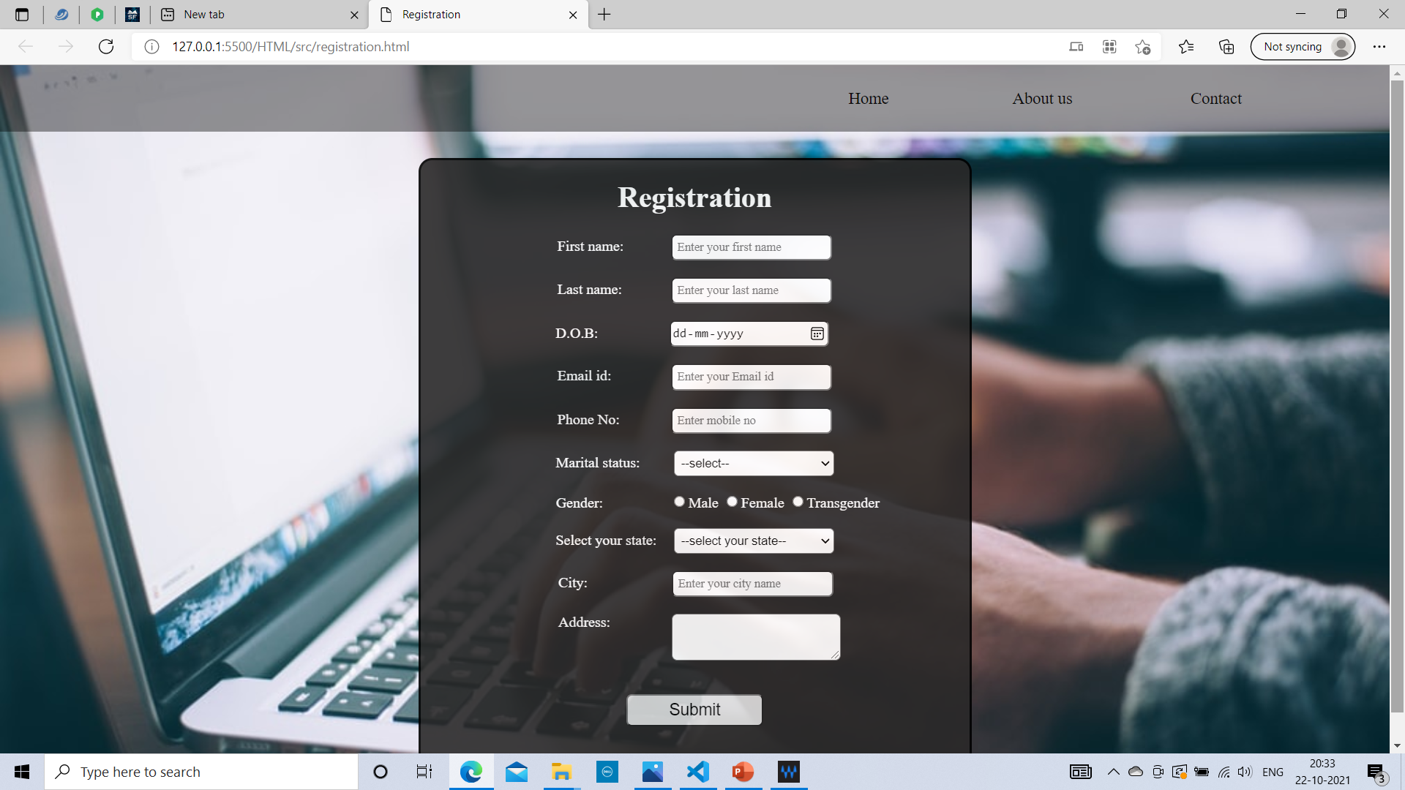
Registration Page

Slide 13
GET ID PAGE
This page was developed by Akshayaa T
This page is to display the generated unique ID and password.
And return to the home page.

Slide 14
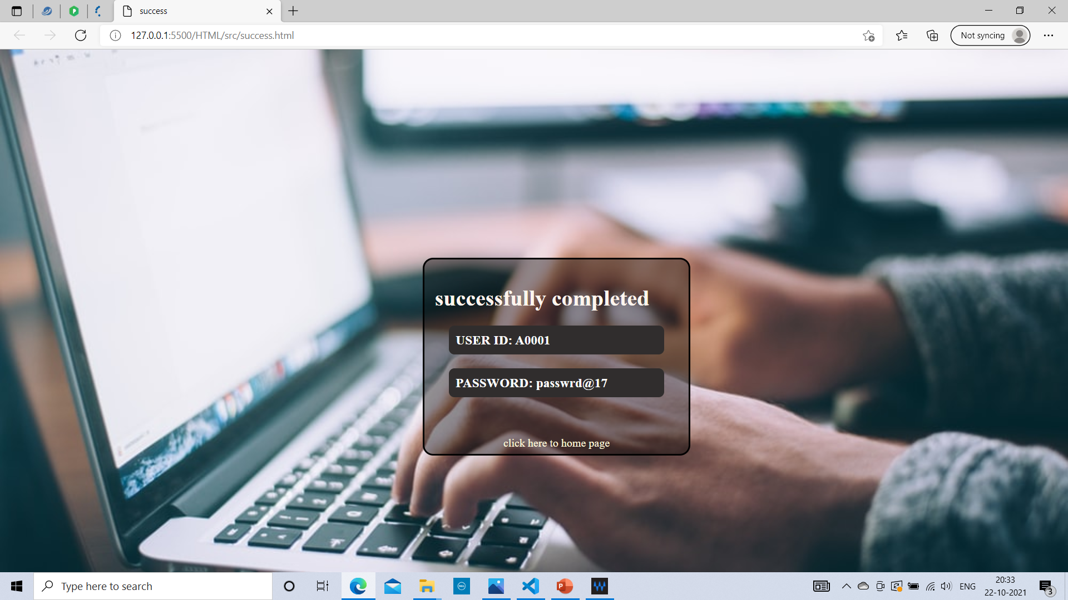
Get ID Page

Slide 15
ABOUT US
This page was developed by Vivek N S
This page is to display the information about the organization and the purpose unique ID code generation.

Slide 16
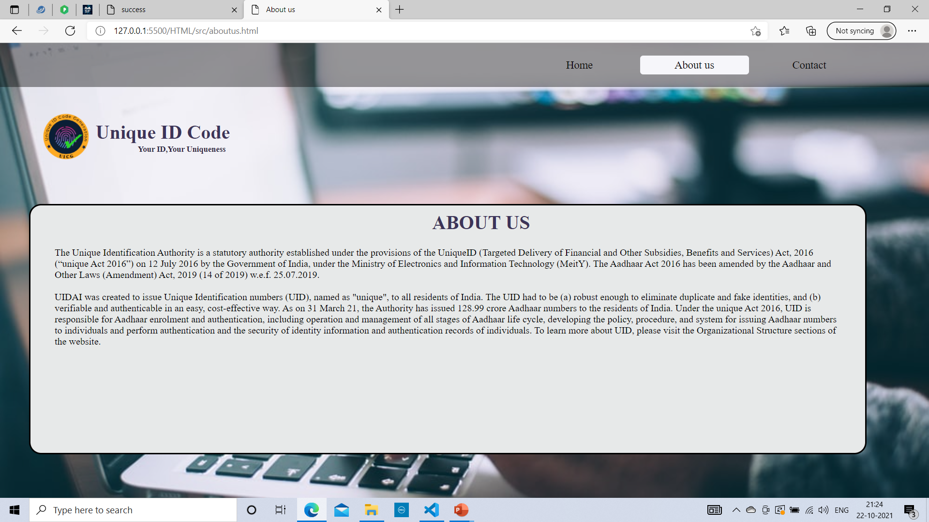
About us page

Slide 17
CONTACT
This page was developed by Vivek N S
This page is to display the Toll Free number and Email ID for any queries.
To help the users, if they face any technical issue with the id generation .

Slide 18
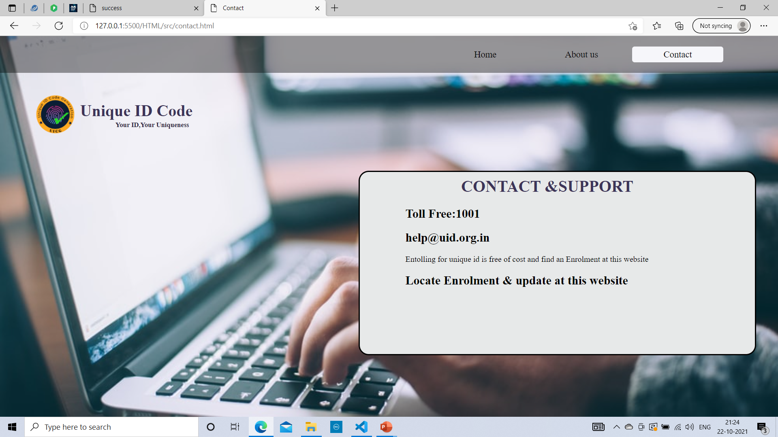
Contact page

Slide 19
CONCLUSION
This project is all about to give identity of the people all around country.
By registering it with proper details, the ID will be generated with the password.
For that we use HTML,CSS,JAVASCRIPT to build this frontend page of this website.

Slide 20


